Slide 1


AIML CA1
Jon Sham (P2317342)

Slide 2





Part B: Predicting Hospital Cost

Slide 3

Introduction
The dataset under consideration aims to predict hospital costs in US hospitals by leveraging a range of patient-related information. Attributes include unique patient identifiers (ID), demographic details such as age and gender, as well as health-related indicators like Body Mass Index (BMI). The objective is to build a predictive model that can effectively estimate hospital costs based on these diverse patient factors, offering valuable insights for healthcare management and resource allocation.

Slide 4
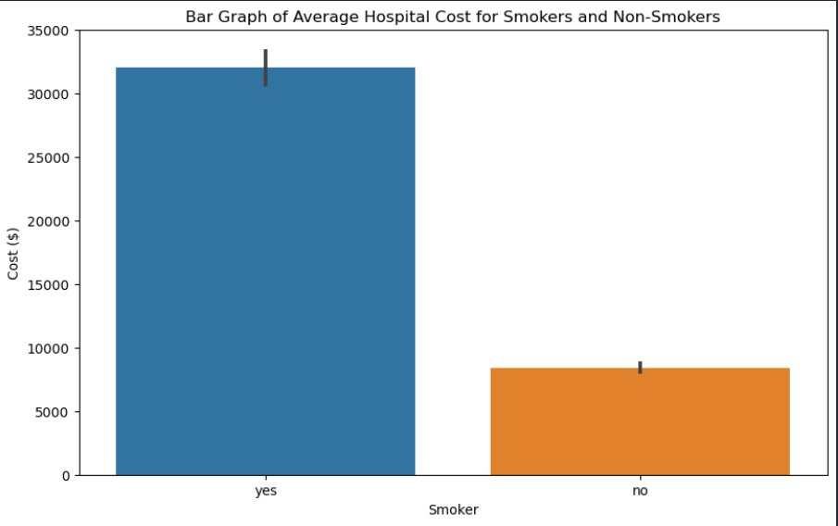
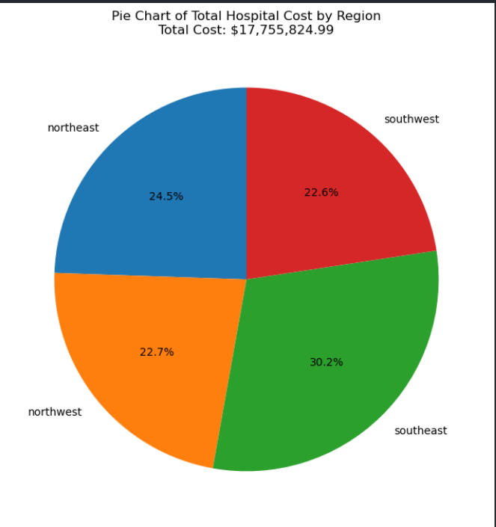
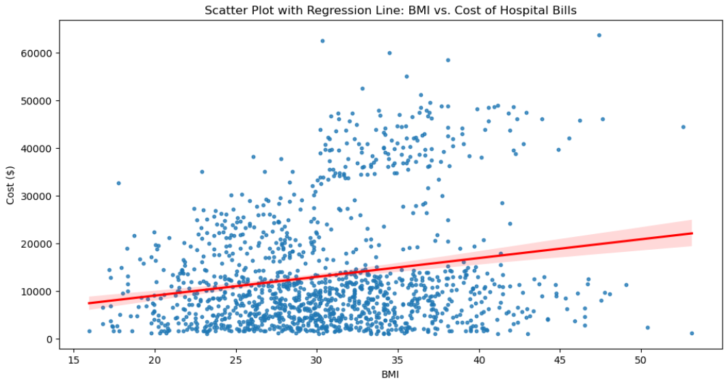
Exploratory Data
For this section, I created different kinds of graphs to visualise the relationships between features and target. Here are some examples of the graphs:
Pie chart to show relationship between region and cost
As we can see, a large chunk of the cost comes from patients from the southeast at 30.2% this could indicate a few things like a greater population in the southeast or more affluent people willing to splurge on hospital cost
Scatter plot with regression line to show relationship between cost and BMI
As we can see, that as BMI increases, the cost increase as shown by the increasing red regression line
Here is a bar graph to show relationship between cost and if patient is smoker
As we can see, if the person is a smoker, the average hospital cost is significantly greater than the average of hospital cost for non-smokers

Slide 5

Conclusion from Data Exploration
From the graphs, I got a great understanding of the features the target and their relationships. From this, I was able to get a feel of the features I felt were more important than the rest this would help me better do feature selection later on

Slide 6
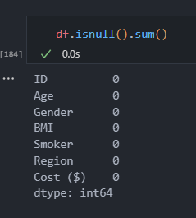
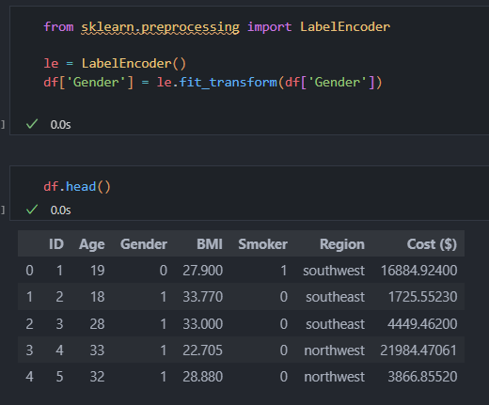
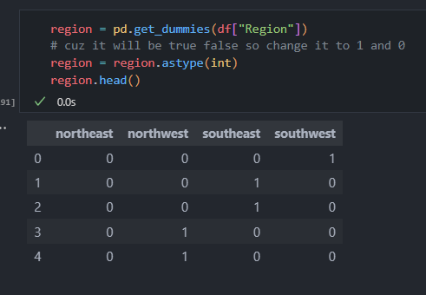
Feature Engineering
First I checked for missing values
Used label encoding to change data in norminal
Used one-hot encoding to change data to norminal
This data set has no missing values
i used label encoding to change data into norminal data for example for female and male i encoded in such that if female = 0 and male = 1 this way the model would be more efficient
i added 4 colums northwest, southeast, northeast and southwest using pd.get_dummies which coverts categorical variables into a binary matrix representaion this would also help with the efficientcy of the model.

Slide 7
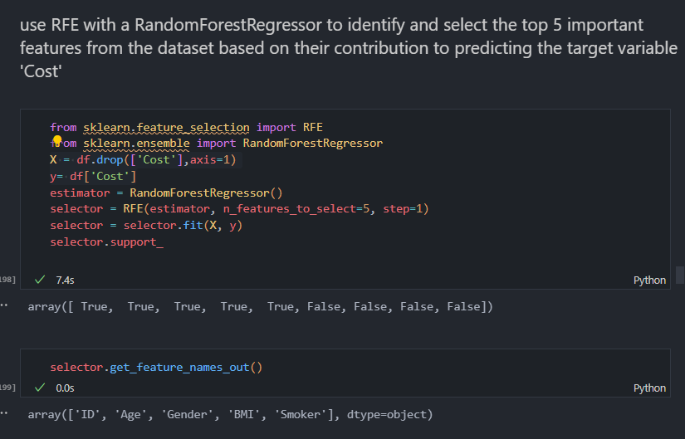
I also used random forest regressor to select top 5 features in the dataset based on their contribution to predicting target variable

Slide 8
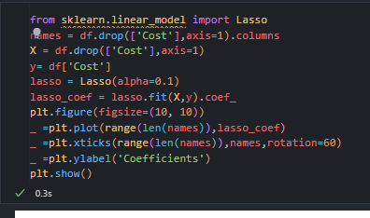
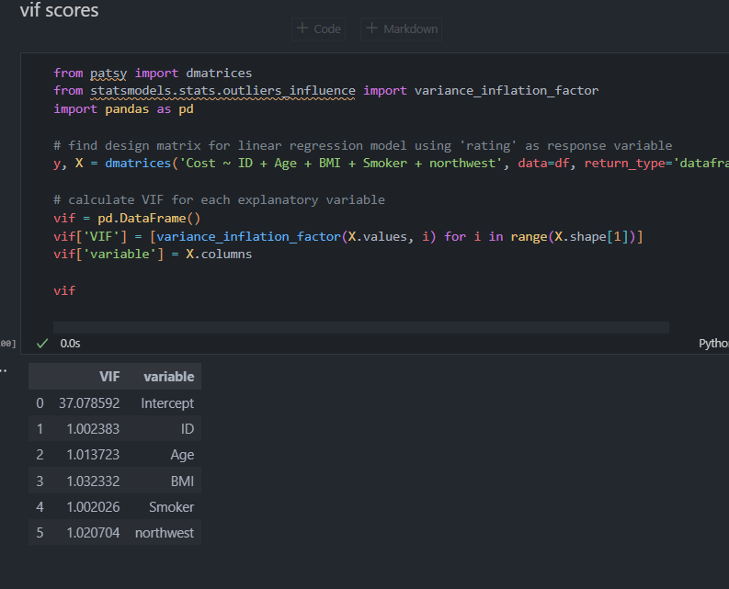
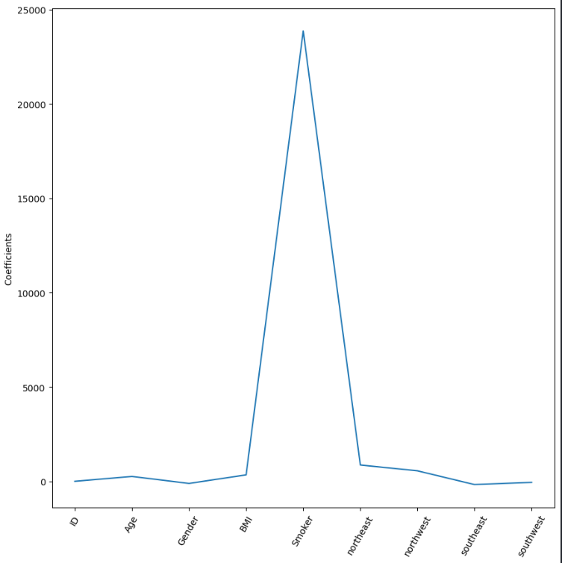
calculated their variance inflation factor to see if there would be multicollinearity and if it was high penalise the features weight using lasso . info VIF > 5: High correlation. Considered problematic, and it might indicate multicollinearity.

Slide 9
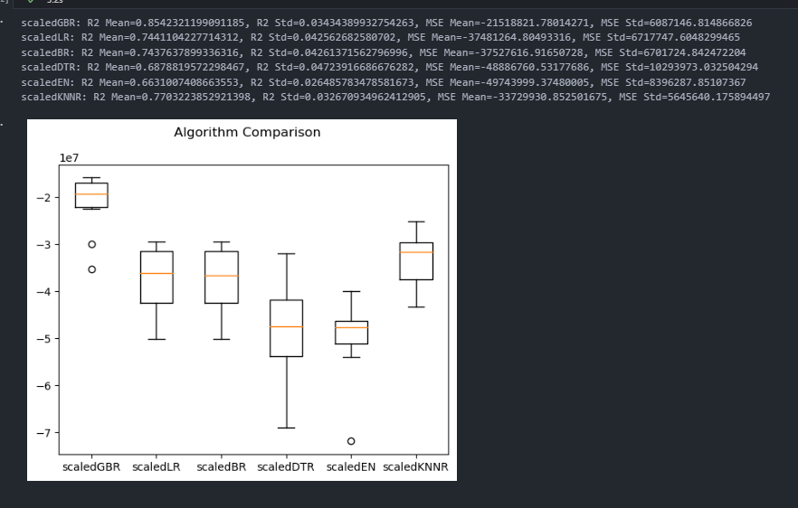
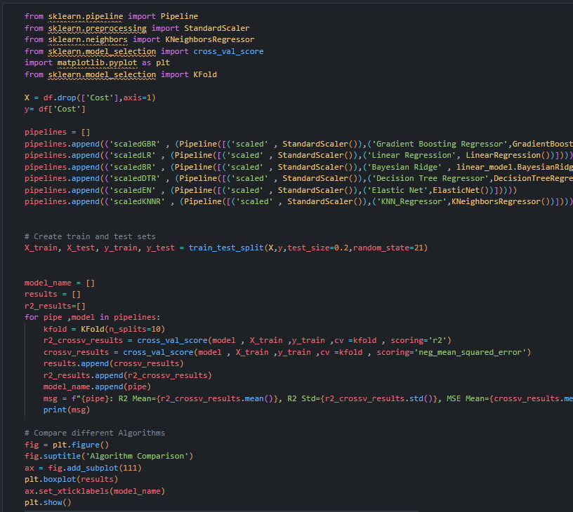
Choosing Best Model
This was done by first, creating a pipeline which runs through using a for loop to calculate R2 mean, MSE Mean and for the model that has the highest R2 mean and the lowest MSE mean would be the most approprate model to be used for the predictions and since it was gradient boosting regressor i chose it to be my model. In this case, Gradient Boosting Regressor has the highest R2 Mean: 0.8542, indicating that it explains a larger proportion of the variance in the target variable. Additionally, it has the lowest MSE Mean, suggesting that its predictions have the smallest average squared differences from the actual values. So i will be picking Gradient Boosting Regressor as my model.

Slide 10
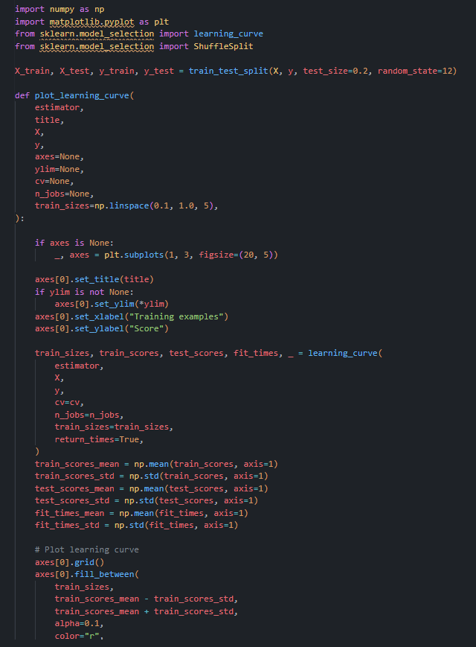
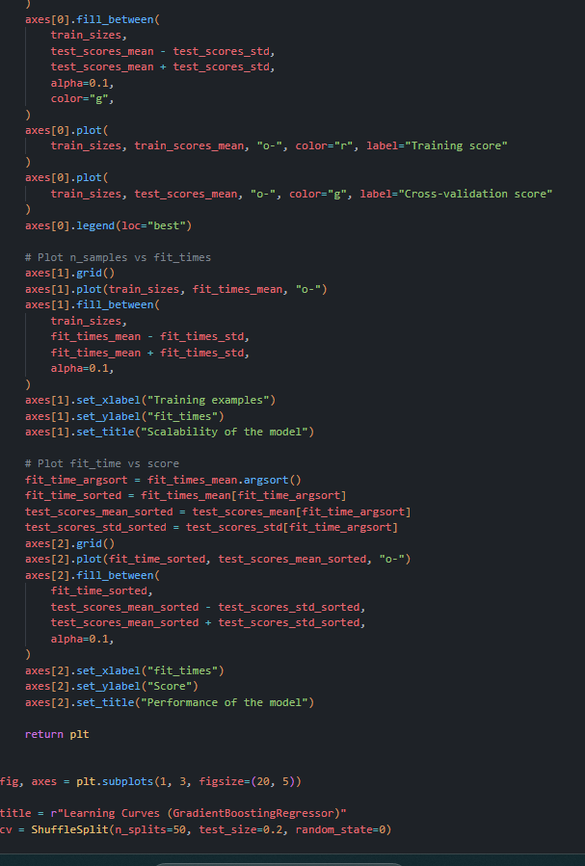
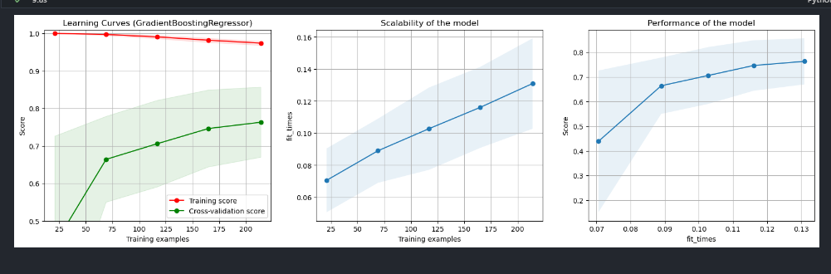
Model Improvement
there is a function that evaluates the quality of a GradientBoostingRegressor using learning curves, which plot training and cross-validation scores against the training set size. The first subplot shows the training and cross-validation scores, aiding in identifying overfitting or underfitting. The second subplot assesses the scalability of the model by plotting fit times against the training set size. The last subplot shows the relationship between fit times and cross-validation scores, offering insights into the model's performance trade-offs. Through these visualizations, the function provides a comprehensive analysis of my system's behavior, hence evaluating my systems performance.

Slide 11
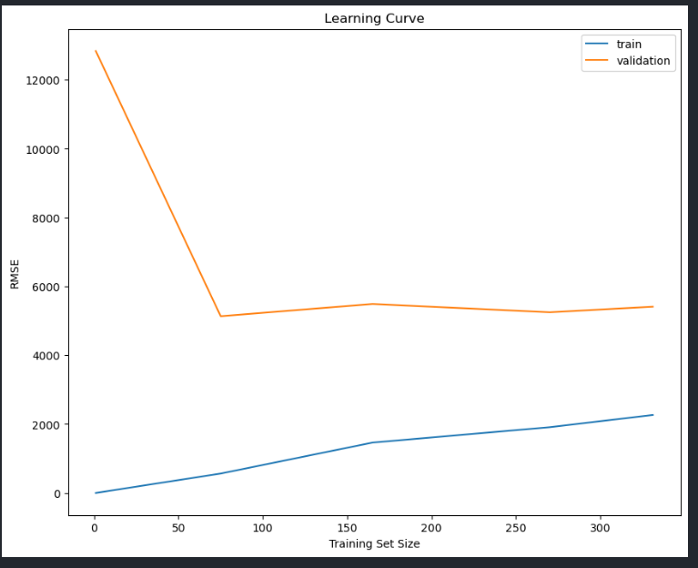
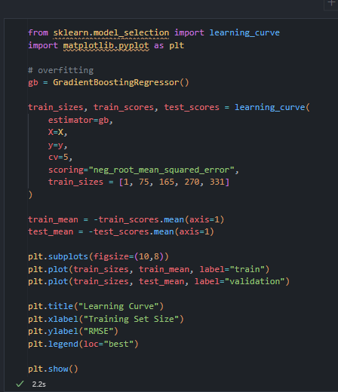
plot the learning curve of beast model to visualize and analyze the performance of a model as it learns from training data over multiple iterations, helping to assess model convergence, identify potential issues such as overfitting or underfitting, and determine the optimal amount of training data for achieving satisfactory performance
In this case, The validation RMSE decreased, showing improved generalization to new data, while the training RMSE slightly increased, indicating a potential risk of overfitting to the training set.

Slide 12
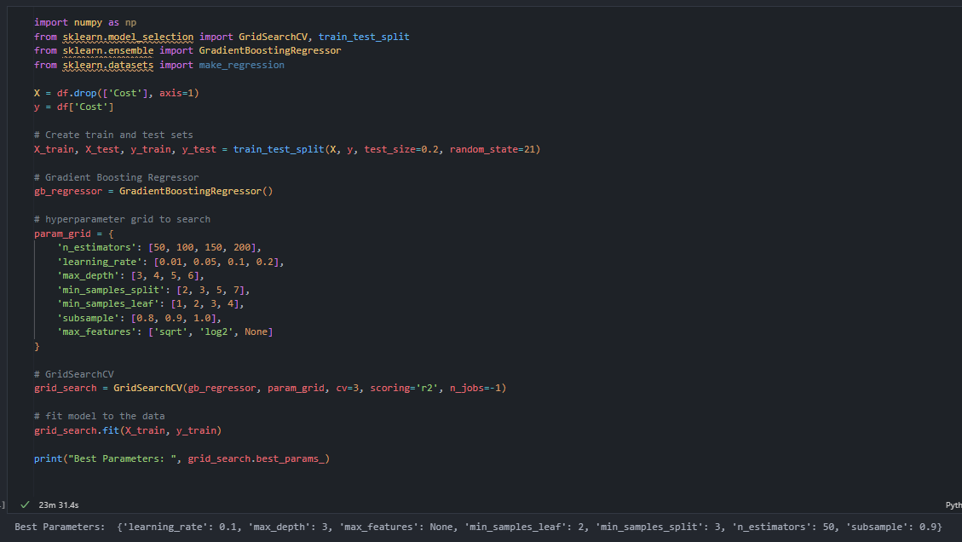
i used GridSearchCV as it is used to systematically search for the best combination of hyperparameter values for a given model. In this case they are learning_rate=0.1, max_depth=3, max_features=None, min_samples_leaf=2, min_samples_split=3, n_estimators=50, subsample=0.9

Slide 13
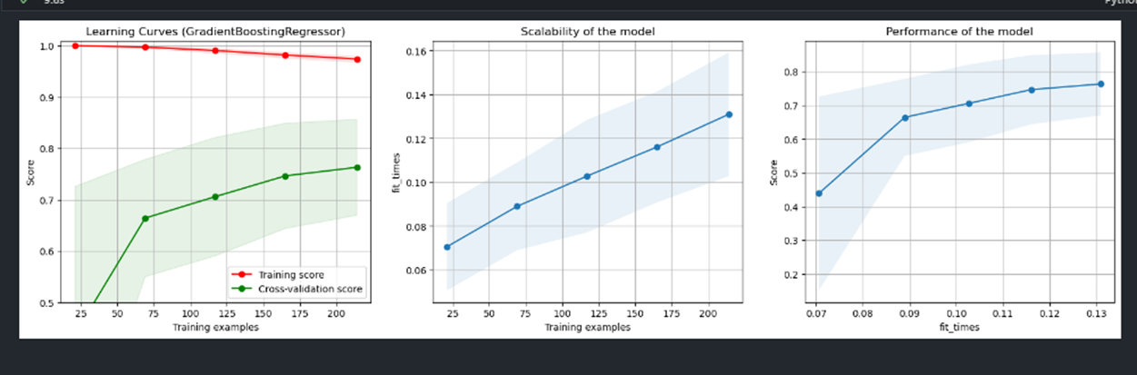
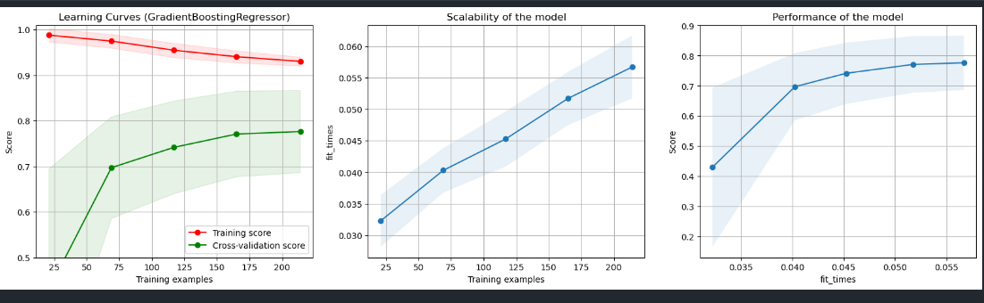
Before:
Plot another learning curve to see the improvements
As we can see after hyperparameter tuning using gridsearch scalability increased, this suggests that as the amount of data or computational requirements increase, the model can adapt and handle the larger workload with
After:

Slide 14
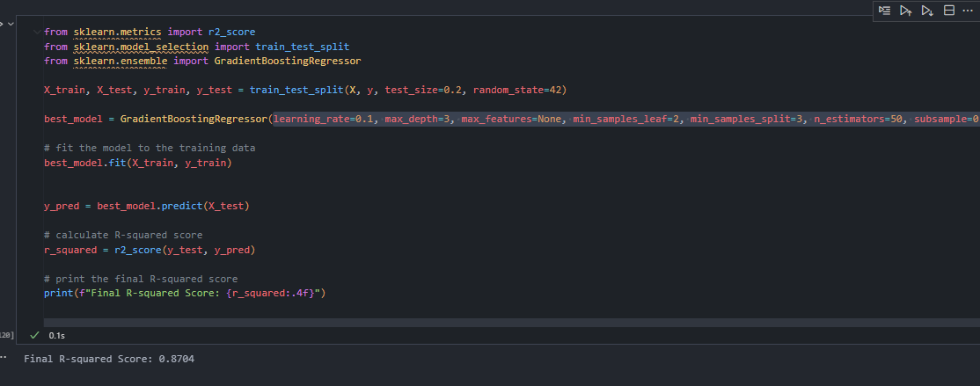
Test the model
After testing the model my model received a r squared score of 0.8704

Slide 15
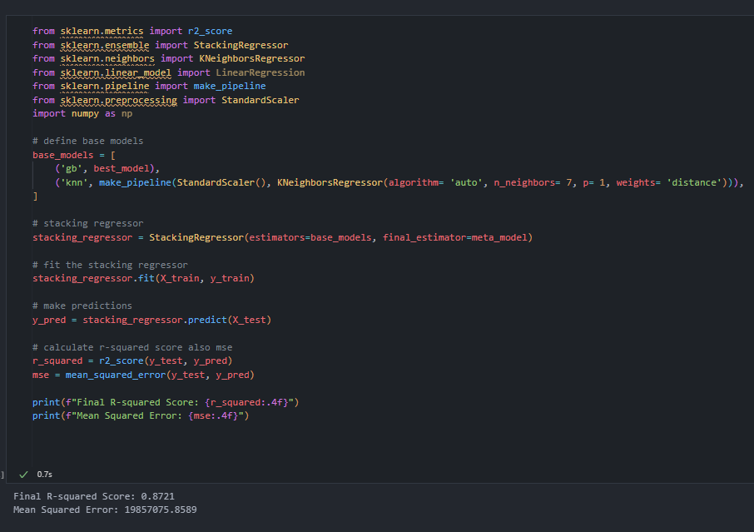
To imove my model further I did stacking. Stacking is an ensemble learning technique that involves combining multiple models to improve predictive performance. In stacking, the predictions of several base models are used as inputs to a meta-model, which then produces the final prediction
In this case, stacking helped improve my model as the final r square score of my model improved from 0.8704 to 0.8721 though it didn’t do much if I had applied parameter to the knn base modes and added more models stacking would have been more effective unfortunately due to time constraints this is all I can show.

Slide 16
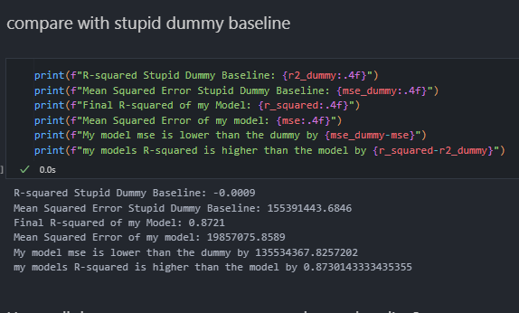
To find out where my model stands in terms of r square I compared my model to a stupid baseline model
In this case, my model outperforms the Stupid Dummy Baseline significantly, as indicated by a higher R-squared value of 0.8721 compared to the baseline's -0.0009. Additionally, the model achieves a substantially lower Mean Squared Error (MSE) of 19857075.8589, showcasing its improved predictive accuracy compared to the baseline's MSE of 155391443.6846. The considerable margin by which the model surpasses the baseline in both R-squared and MSE underscores its effectiveness in capturing and predicting patterns in the data.

Slide 17
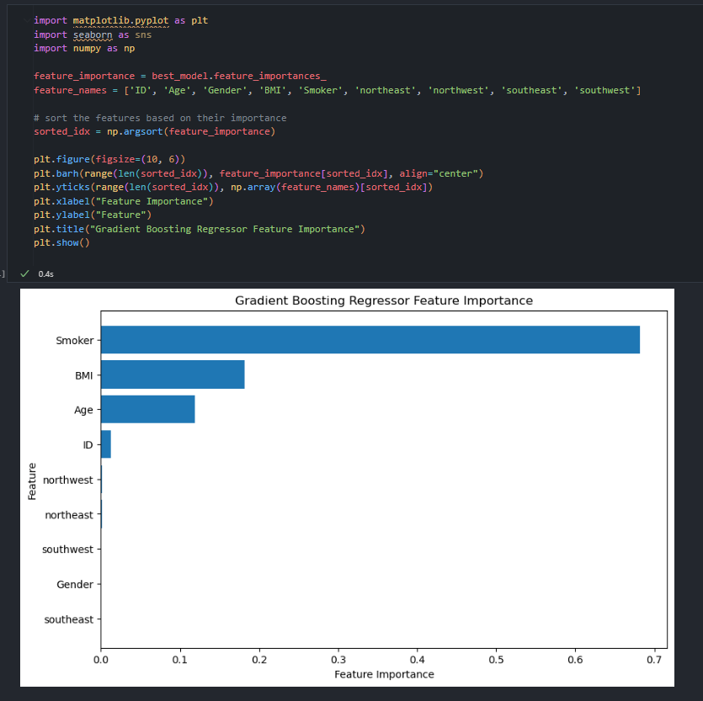
Lastly I plotted a bar graph to show feature importance of the gradient booster regressor
As seen in the graph above the model ranked Smoker as the top contributer at feature importance close to 0.7 hence means considers this feature as important

